Slide 1

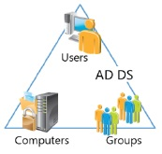
NI
LECTURE
Windows Server 2016:
Managing Users, Groups and Computers
9
Networking Infrastructure
Diploma in CSF/IT
Year 2 (2022/23), Semester 3
Notes:
1

Slide 2
Objectives
At the end of this, you will be able to :
Create User Accounts
Modify User Account Properties
Creating a User Account Template
Create Computer Accounts
Modify Computer Accounts.
Enabling and Unlocking User and Computer Accounts
Resetting User and Computer Accounts
Create and manage groups.
Notes:
2

Slide 3
User, Group & Computer Account Administration
Creating and administering user accounts, group accounts and computer accounts is an important task for an administrator.

Slide 4
What Is a User Account?
To access Windows 2016 network a user needs an account.
Account determines 3 factors: when a user may log on where within the domain/workgroup what privilege level a user is assigned
Each account has a SID (Security ID) that serves as security credentials.
Any object trying to access resource must do it through a user account
Notes:
4

Slide 5
Type of User Accounts
Local Users Accounts | Domain User Account
Maintained on the local system/computer and not distributed to other systems | Created within a domain container in AD database and propagated to all other DCs
Supported on all Windows Operating Systems except Domain Controllers | Permit access throughout a domain and provide centralized user administration through AD
Authenticates the user for local machine access only; access to resources on other computers is not supported | Once authenticated against AD database, a user obtains an access token for the logon session, which determines permissions to all resources in the domain
Local user account Built-in-local accounts: Guest; Administrator
Notes:
5

Slide 6
Creating User Account
Use Active Directory Users and Computers (ADUC) Tool.
Domain accounts names must be unique within the domain, although the same logon name can be used on several systems with local logon.
Logon names are not case sensitive, must not contain more
than 20 chars, and must not contain: +,*,?,<,>,/,\,[,],:,;.
Notes:
6

Slide 7
Configuring User Account
Once the account is created, those properties may be modified using Computer Management tool (local accounts) or AD Users and Computers (domain accounts).
Copy:
Copy many settings (except the username, full name, password, logon hours, address/phone info, organization info, the Account is disabled option, and user rights & permissions) of an existing user account and create a new account with the same settings. Useful for creating multiple same users from a disabled template account.
Notes:
7

Slide 8
Configuring User Account
Add user to a Group: Add a user account to a group
Disable Account: To temporarily make an account unusable.
Reset Password: Reset passwords for users that have forgotten them.
Move: To move the user accounts to another folder or OUs. Drag and Drop.
Rename: Renaming account doesn’t affect any of the user account properties, except the name.
Open Home Page: Launch default browser to user-specified home web page.
Send Mail: Send a email to the user’s e-mail address.
Delete: Permanently removes it, and all if its group memberships, permissions and user rights. The new account with the same name has different SID. Disabling an account may be a better option. Administrator and Guest can be renamed, but not deleted

Slide 9
User Account Properties
“Member Of” Tab:
Provide a list of the groups this user is a member of. Can add and remove group membership
“Profile” Tab:
Settings determine how and where a user’s profile resides. Can map a network drive to a specific home directory.
“Account” Tab:
Specify logon hours allowed for the user
Specify which computers the user can use to log in
Specify when account will expire.
Notes:
9

Slide 10
Configuring multiple user objects
Select all the user objects and right click, select Properties.
Edit the properties and these edited properties will apply to all the user objects.
Notes:
10

Slide 11
What Is a Computer Account?
To access Windows 2016 domain a computer needs an account.
Computer account identifies a computer in a domain. Each computer account has a SID.
Has the same name as the computer and must be unique within the same domain.
Logical representation in Active Directory of the physical computer object.
Can be granted permissions to other objects and be subject to group policy.
Can be made a member of a group.
Is required for every computer joining Windows Server 2016 AD.
Notes:
11

Slide 12
Why Do We Need A Computer Account?
Security
Authentication – specifying which computers has access to the Active Directory. Not only a user with the correct username and password to log on, but need to log on from a computer that is a member of the domain.
Auditing computer access
Management
Active Directory features:
Software Deployment
Desktop Management
Hardware and software inventory
Notes:
12

Slide 13
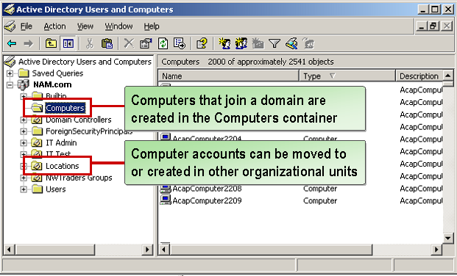
Where Are Computer Accounts Created in a Domain?
Using a drag-and drop operation or by right clicking a computer object and selecting Move command, you can relocate a computer to another OU.
Notes:
13

Slide 14
Why do we move computer objects to a OU?
Better keep track of various workstations and client computers that are part of your domain by organizing them according to your organization logical structure.
OU structure in which the computer account resides will determine which policy settings will apply to the computer.
Notes:
14

Slide 15
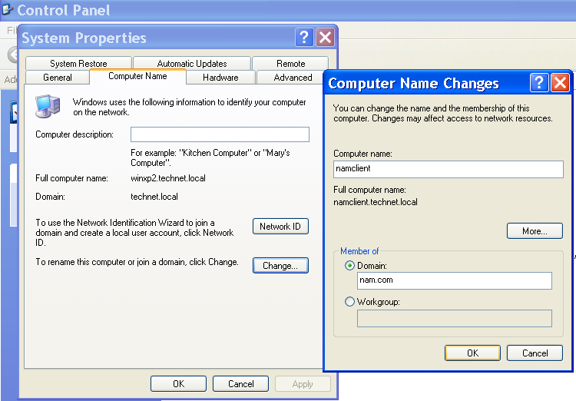
Creating Computer Account – Method 1
When this computer joins the domain, a computer account is created automatically in Active Directory.
Computer object must exist in Active Directory before computer can be joined to the domain.
Computer account objects created automatically when an authorized user (system administrators) adds (join) a computer to a domain.
Notes:
15

Slide 16
Creating Computer Account – Method 2
Computer Accounts can be created manually using Active Directory Users and Computers Tool.
Right click on Computer folder and select New | Computer.
Enter the name of the computer.
Decide which users or groups can join this computer to domain. Default setting is only to members of the Domain Admins group
Notes:
16

Slide 17
Managing Computer Accounts
Disable: To prevent users from logging in from a particular computer regardless of user account permissions. Disabled computer accounts displayed with red X above computer icon. No information is deleted.
Enable: To enable disabled computer accounts.
Reset : Re-establishes computer-based authentication information between a computer and Active Directory. Solve issues when computers are unable to log in.
Delete: Once a computer account is deleted, no users will be able to log on from the computer. Although a new computer account with the same name can be created, the new account will not automatically inherit any permission or other settings that the old computer might have.
Notes:
17

Slide 18


What Is a Group Account?
Groups are AD objects that contain users, computers and/or other groups. Have SIDs
Using groups , administrator can quickly and easily make changes that can affect many users simultaneously.
Simplify administration by enabling you to assign permissions for resources.
Notes:
18

Slide 19
Group Account - Members
Group 1
Group 3 is a member of Group 1
Group 2
Group 3
A user can belong to multiple groups.
Up to 5000 members in a group
Groups can contain other groups.
Notes:
19

Slide 20
Group Account – User Rights
User’s rights and privileges through group memberships are cumulative. He will have a combination of all of the permissions that are assigned to her user account and any permission that are assigned to any groups of which he is a member.
Assign permissions to groups.
Whenever permissions are granted or denied on group objects, the permissions will apply to all members of these groups.
Recommended Practice:
Place users in groups and assign permissions (rights and privileges) to groups instead of directly to users.
Notes:
20

Slide 21
Group Account - Type
Groups are characterized by scope and type
Distribution Group
For purpose of email messaging . Cannot be assigned permissions or user rights.
Security Group
Assign permissions or user rights to group that need access to resources.
Can convert security groups to and from distribution groups.
Notes:
21

Slide 22
Group Scope - Types
Group scope determines whether the group spans multiple domains or is limited to a single domain
Three group scopes are:
Domain local
Global, and
Universal

Slide 23
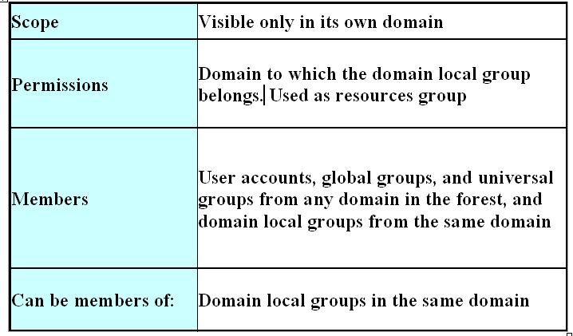
Group Scope – Domain Local
Domain Local Groups:
Used to assign access permissions to resources within a single local domain only.

Slide 24
Domain Local Group Example
Domain C
Domain B
Domain A
Sales Group
(Global)
James
Keith
Printer Group (Domain Local)
James Sales Group
Keith
Printer ACL:
Printer Group - Print
Notes:
Domain local groups are used primarily to manage permissions to resources e.g. Printer Group.
Assume all domains are in the same forest and therefore have 2-way trust.

Slide 25
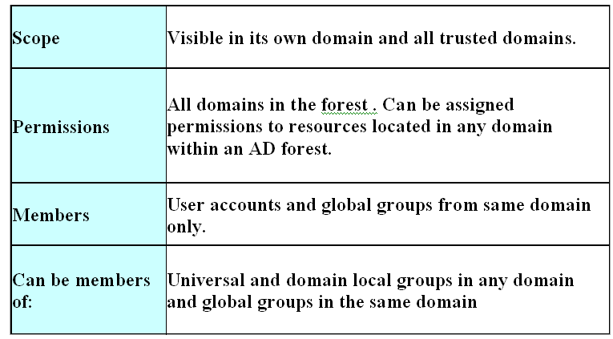
Group Scope - Global
Global Groups:
Can be granted access to resources in other trusted domains, or placed into domain local groups in any trusting domain.
Notes:
25

Slide 26
Global Group Example
Domain B
Domain A
Admin Group
( ? )
James
Sales Group
(Global)
Sales Group
Domain C
Accountants (Global)
Printer C
(Domain Local)
James
Sales Group
Accountants
Printer ACL:
Printer C - Print
Notes:
Global Groups are used primarily to define collections of domain objects based on business roles.
i.e. Role groups such as Sales Group and Accountants would be created as Global Groups.
Note: Members can be User accounts and Global groups from the same Domain only (Domain Local Group cannot be added).
Global groups can be added to Domain Local groups or Universal groups in another domain.
Question: What is the Group Scope for Admin Group in Domain B ?

Slide 27
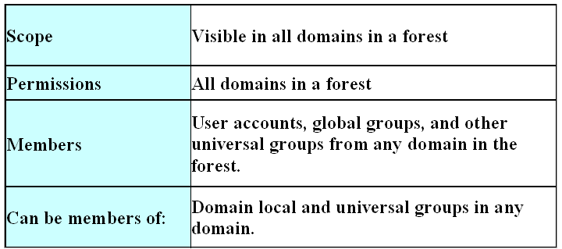
Group Scope - Universal
Universal Groups
Grant access to resources in all trusted domains
Can be granted access to resources in any domain
Notes:
27

Slide 28
Group Strategy
Put users into global group.
A global group can be thought of as an Accounts group.
Put resources into domain local groups.
A local group can be thought of as a Resource group.
Put a global group into any domain local group in the forest.
Assign permissions for accessing resources to the domain local groups that contain them.

Slide 29
Group Strategy Example
Domain A
Domain B
ITGroup-A
(Global)
ITGroup-B (Global)
Database Access (Domain Local)
Domain C
ITGroup-A ITGroup-B ITGroup-C
ITGroup-C (Global)
Database ACL: Database Access - Read/Write
Database

Slide 30
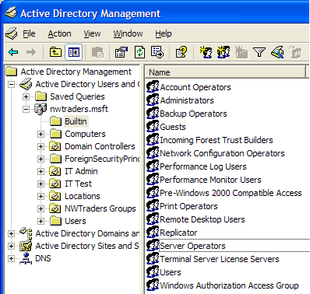
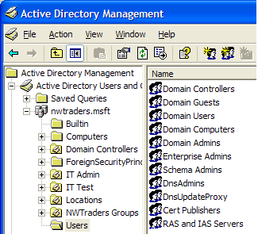
Built-in Groups in Active Directory
Default groups are automatically created during installation
Use Default groups to control access to shared resources and Delegate specific domain-wide administration
Notes:
30

Slide 31
Built-in Groups in Active Directory
Some built-in groups include:
Administrators | Members have complete and unrestricted access
Account Operators | Members can administer domain user and group accounts
Print Operators | Members can administer domain printers
Guests | Have access as members of users group but is further restricted
Remote Desktop Users | Members are granted rights to log on remotely
Notes:
31

Slide 32
Creating Group Account
Use Active Directory Users and Computer Tool.
Groups can be created within any folders or OUs.
Use Active Directory Users and Computer Tool.
Groups can be created within any folders or OUs.
Use Active Directory Users and Computer Tool.
Groups can be created within any folders or OUs.

Slide 33
Add Members to a Group
Use Active Directory Users and Computer Tool.
Members Tab: To add or remove users or groups
Members Of Tab: View a list of groups that this group is a member of.
Notes:
33

Slide 34
Determining Users’ Group Membership
Use Active Directory Users and Computer Tools. Right click on user account and select Properties. Click on Member Of Tab.
Can add or remove user from groups.
Notes:
34

Slide 35



The Members and Member Of Properties
Group or Team
Global Group
Domain Local Group
Tom, Jo, and Kim
SPORE Admins
Denver Admins
ASIA Admins
Members | Member Of
N/A | SPORE Admins
Members | Member Of
Tom, Jo, Kim | ASIA Admins
Members | Member Of
SPORE Admins, KL Admins | N/A
Sam, Scott, and Amy
KL Admins
Members | Member Of
N/A | KL Admins
Members | Member Of
Sam, Scott, Amy | ASIA Admins
Notes:
35

Slide 36
Best Practices
Create Naming Conventions
Use first initial and full last name of an employee as username.
Group for temporary employees begin with “Temp-Sales”.
Rename Administrator account
For security reason since everyone knows the username is “administrator”.
Assign users to groups and then assign permissions to group.
Reduce the effort required to grant permissions to resources.
Notes:
36

Slide 37
Best Practices
Design group structure and assign permission to groups (instead of users)
Create groups that reflect you organization (i.e Marketing, Accounting User).
Disable an account that will not be used immediately.
Require users to change their passwords the first time that they log on.
Notes:
37

Slide 38
Summary
Users need both user accounts and computer accounts to access Active Directory domain.
Active Directory Users and Computers administrative tool is used to create and manage user, group and computer accounts.
A group is an object that consists of a list of users, computers and/or other groups.
All permissions assigned to the group are inherited by its members.
Group simplify administration by enabling you to assign permissions for resources.
Groups are characterized by Group Type (Security or Distribution) and Group Scope (Domain local, Global and Universal) .
Notes:
38

Slide 39
Summary
Security groups can be assigned permissions, while distribution groups, such as e-mail distribution groups, cannot be assigned permissions to a resource.
Domain local groups are used for assigning permissions to resources. Global groups are used for gathering together users with similar resource requirements. Universal groups are used primarily to grant access to related resources in multiple domains.
Group Strategy: Put a global group into any domain local group in the forest. Assign permissions for accessing resources to the domain local groups that contain them.
Notes:
39

